Slide 1







WAN Mode Server must have a fixed DNS name.
Perfect for Internet deployments.
LAN Mode No fixed server IP or name.
Perfect for local networks.
Hybrid Mode Both LAN and WAN mode.

Slide 2

MeshCentral
Agent Device Group
LAN, WAN, Hybrid
MeshAgent
Intel® AMT
MeshCentral
Intel® AMT Device Group
LAN, WAN , Hybrid
Intel® AMT
MeshCentral
Local Device Group
LAN , Hybrid
Applications

Slide 3
SSH, FTP, VNC
RDP

Slide 4
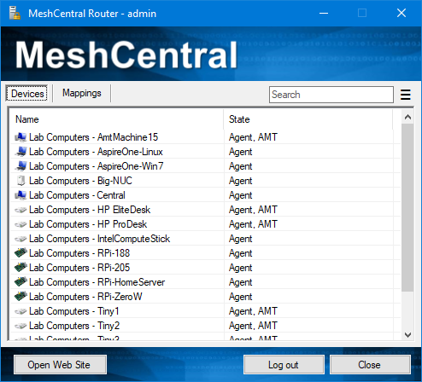
MeshCentral
Server
MeshAgent
MeshCentral
Applications

